Slide 1


Welcome
To My
Presentation
Presented By:
Rifah Tasnia Raisa

Slide 2

Care ethics
Introduction
Care ethics is an approach in moral philosophy that argues:
Morality is rooted in caring relationships and the responsibility to respond to others’ needs.

Slide 3
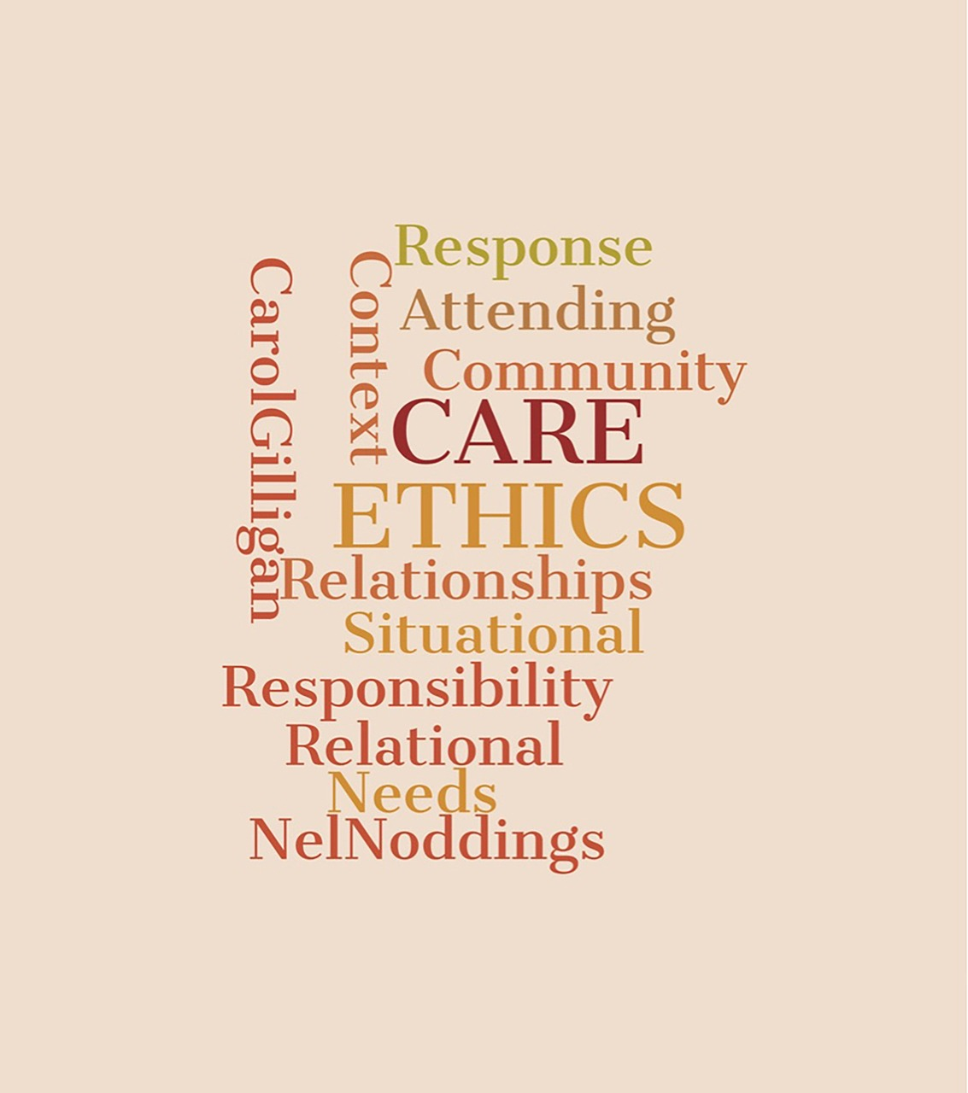
Key Features
Focus on Relationships
Emotion Matters
Context-Based Decisions
Instead of treating everyone the same, care ethics values close relationships like family, friends, and community.
Empathy and compassion guide decisions
It rejects strict rules. What is right depends on the situation and people involved.

Slide 4

Key Thinkers
Carol Gilligan –
criticized traditional ethics for ignoring women's perspectives
Nel Noddings –
emphasized caring as the foundation of ethics

Slide 5
Example
Imagine your friend is sick before an exam:
A rule-based theory might say: “Follow rules, don’t help if it breaks fairness.
Care ethics says: “Help your friend because they need care and support.”

Slide 6
Strengths
Promotes kindness, empathy, and human connection
Reflects real-life moral decisions
Values personal relationships

Slide 7
Criticisms
Can be biased (favoring close people over strangers)
Lacks clear rules → may cause confusion
May ignore justice or fairness sometimes

Slide 8
Conclusion
Care ethics teaches that being moral is not just about following rules, but about caring for others and maintaining meaningful relationships. It brings a more human and emotional side to ethical thinking.

Slide 9
Thank You
Very Much!

